Slide 1
FAOSD Programme
Getting Started….
Kong Cheong Tuck
FS Expert
20 - 21 Oct 2014

Slide 2
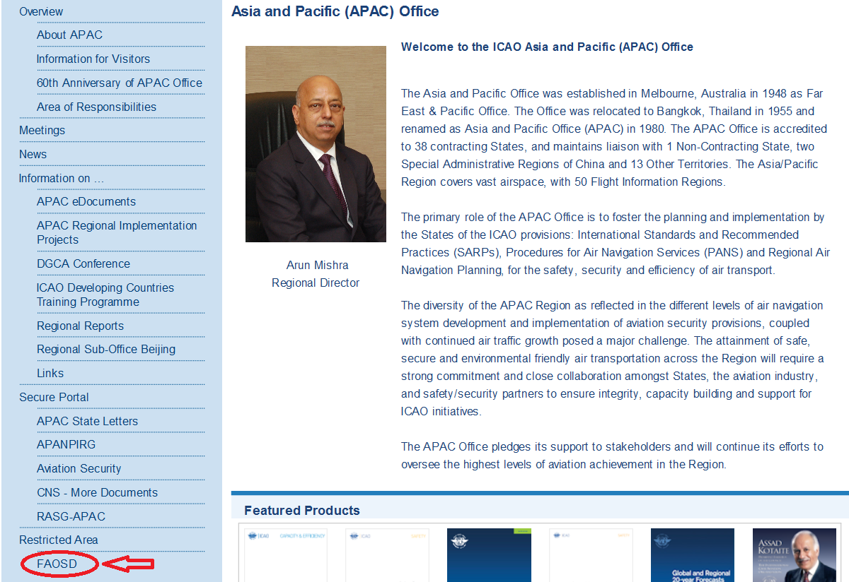
Getting Started

Slide 3

Getting Started – Website
ICAO APAC public website to the FAOSD…..
http://www.icao.int/APAC/Pages/default.aspx

Slide 4
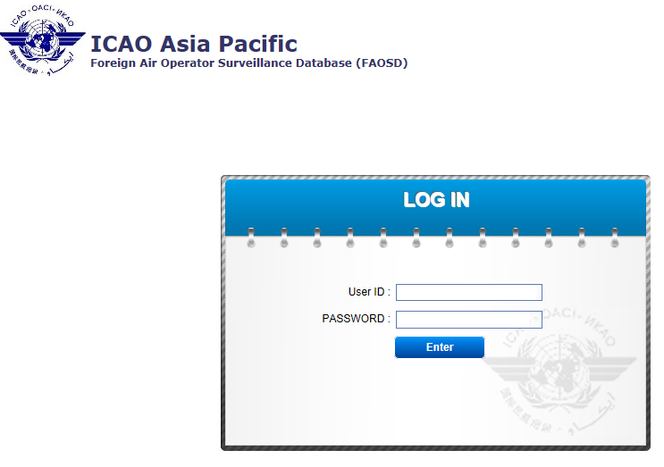
Getting Started – Logging-in

Slide 5
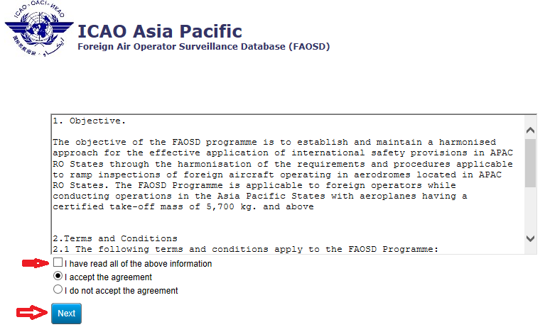
Getting Started - Agreement

Slide 6
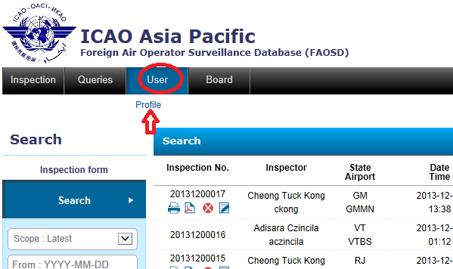
Getting Started: Change Password

Slide 7
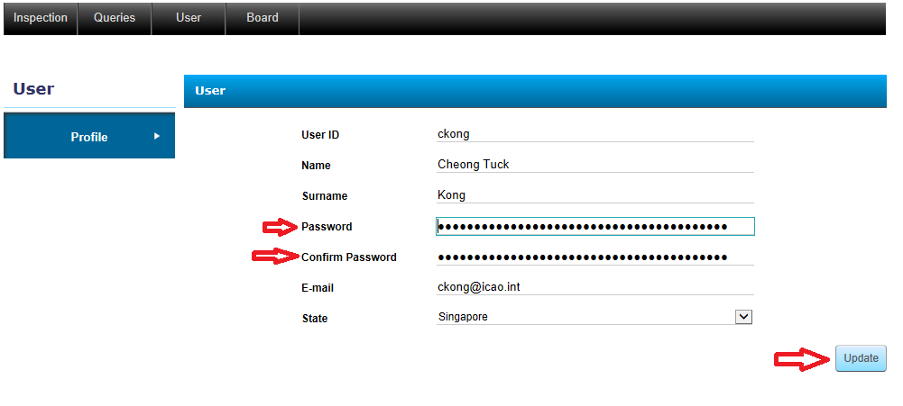
Getting Started: Change Password

Slide 8
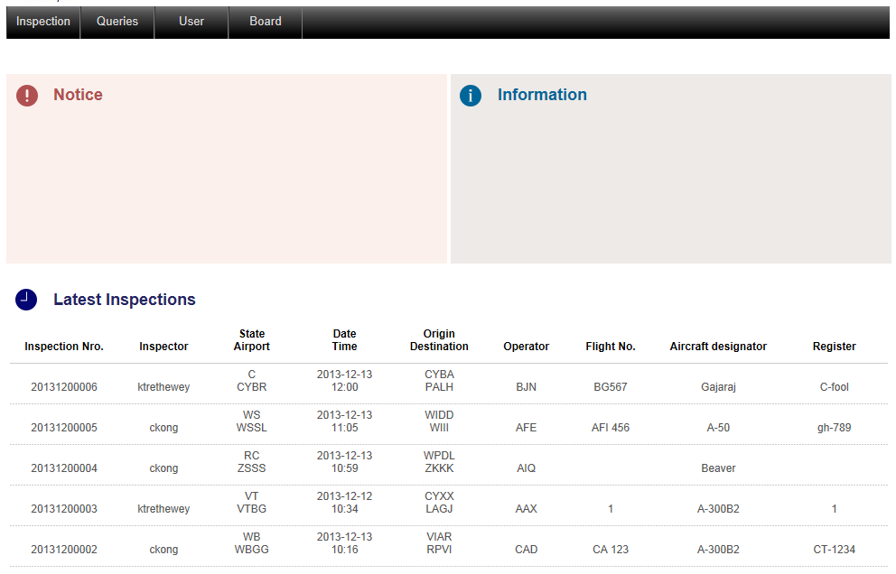
FAOSD Programme

Slide 9
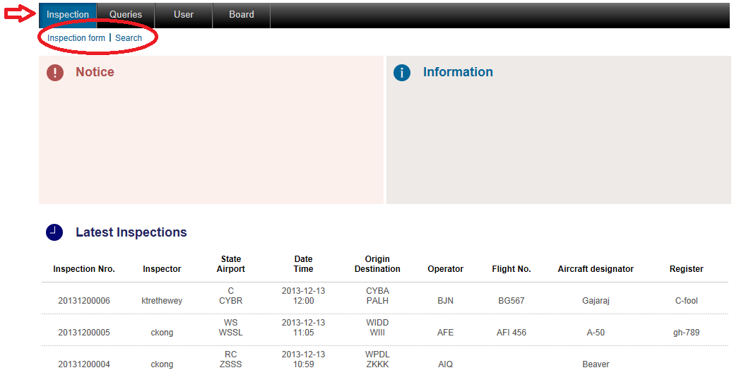
Inspection Function

Slide 10
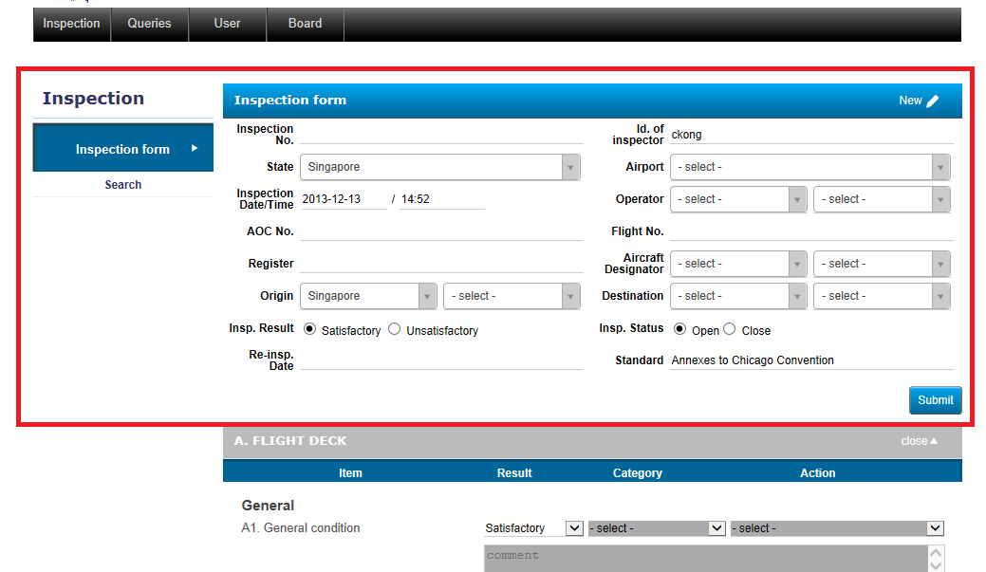
Inspection Form:
Generating a new Inspection Report

Slide 11
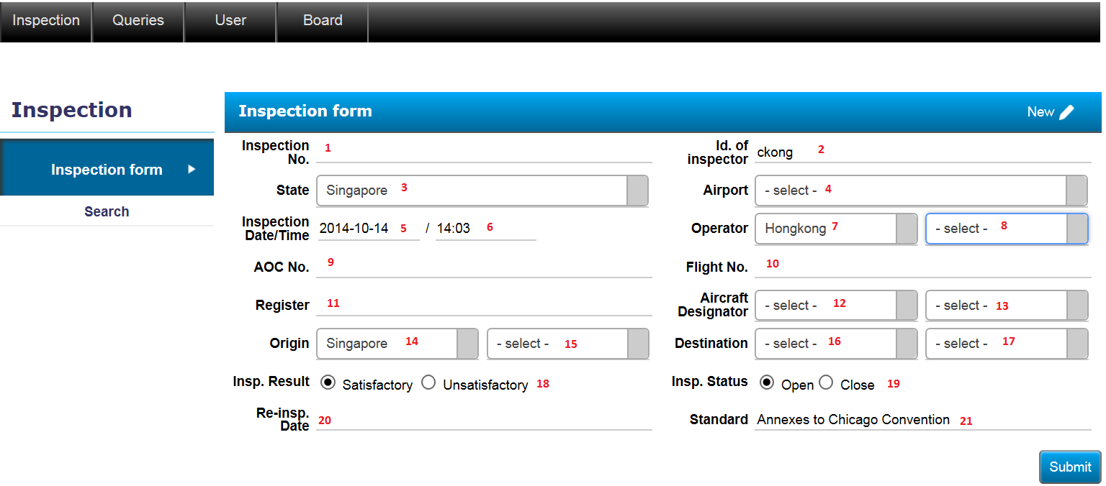
Inspection Form

Slide 12
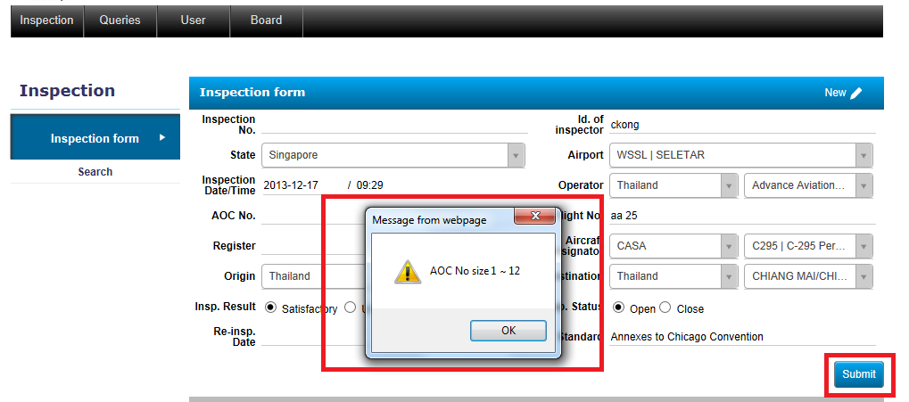
Inspection Form:
Incomplete information

Slide 13
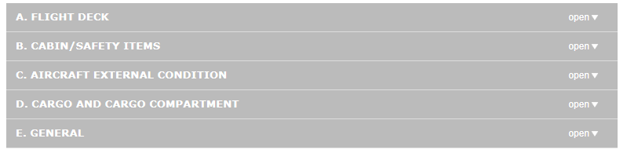
Inspection Form: Areas of inspection
Five Inspection areas

Slide 14
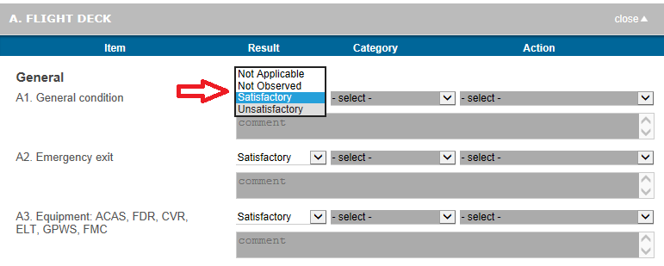
Inspection Form: Result of Inspection
N/A, Not Observed, Satisfactory and Unsatisfactory
Comment needed when inspection result is Unsatisfactory

Slide 15
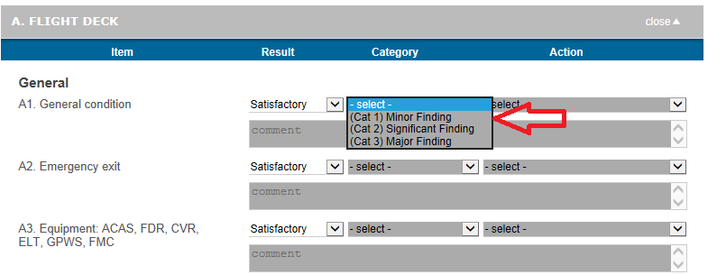
Inspection Form: Categories of Finding
Doc 8335 Part VI Chapter 6.

Slide 16
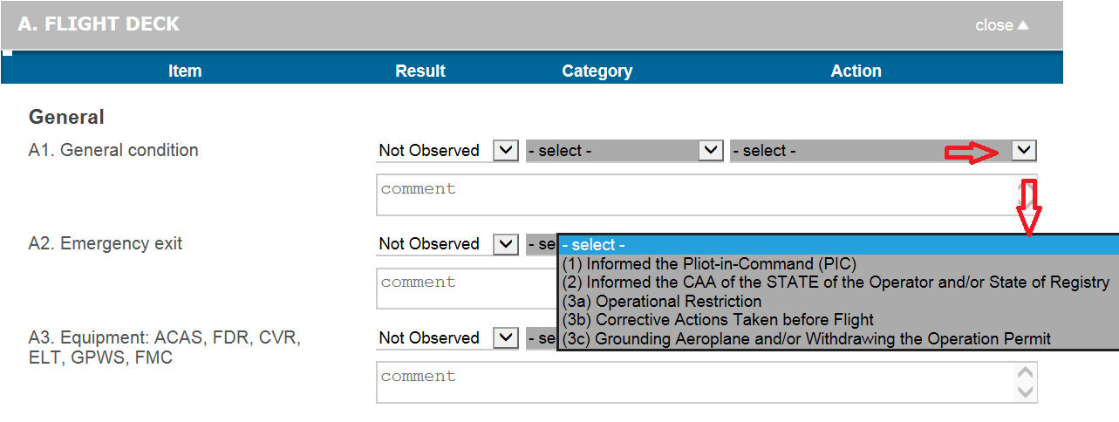
Action Taken

Slide 17
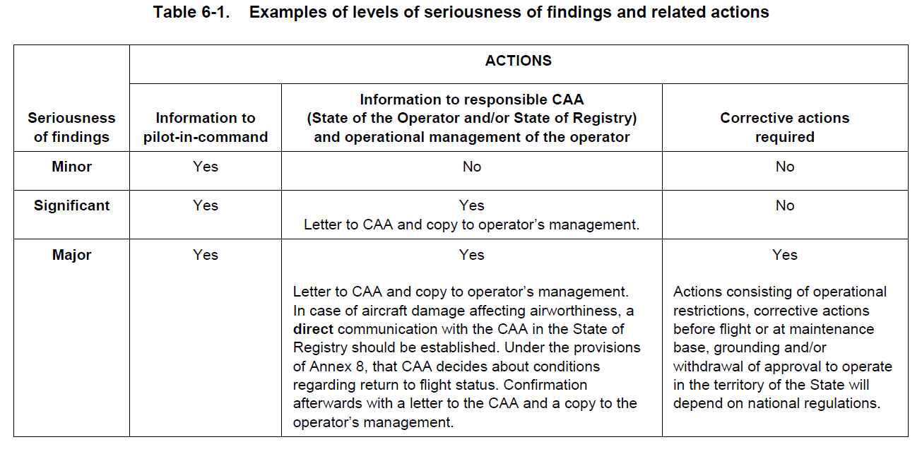
Inspection Form: Category of Finding and Recommended Actions

Slide 18
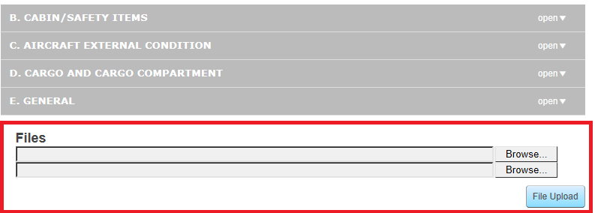
Inspection: Evidence
For uploading of e-evidence – not working yet.

Slide 19
Inspection
Thank You!
Q&A?

Slide 20
Exercise 1
Completing and Entering Inspection Report into the FAOSD
5 – 10 inspections, more if available.
Provide actual experiences where possible
Create deliberate errors or incorrect entries for corrective action

